Slide 1

Human Trafficking Data Analysis
Project 1:
Elizabeth Harrison
Lisa Jemmings
Shirley Limburg;
Saron Raut
Mara Schemel
Sumit Patel

Slide 2
Fight the Plague of Human Trafficking
USA Human Trafficking Statistics 2.7 per 100k – 11,500 human trafficking cases reported in 2019 https://worldpopulationreview.com/state-rankings/human-trafficking-statistics-by-state
Worldwide, an estimated 20.8 million people are victims of human trafficking, contributing to an industry that generates more than $150 billion in illegal profits. https://www.dhs.gov/sites/default/files/publications/4146_CombattingHumanTraffickingThroughSocialScience.pdf
Third point
Fourth point
Questions you found interesting and what motivated you to answer them

Slide 3
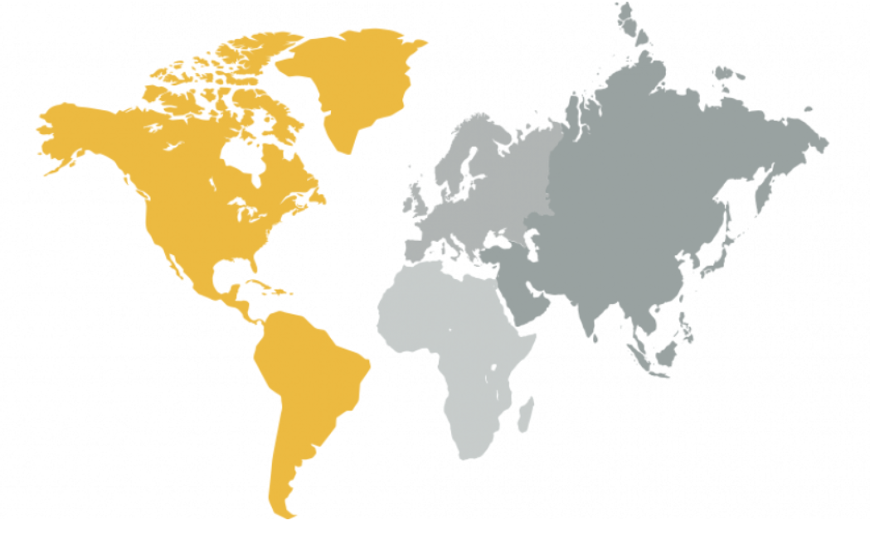
Counter Trafficking Data Collaborative and World Bank
Where and how you found the data you used to answer these questions

Slide 4
Data Integrity Could be Improved
Dataframe showing unknowns
Another example
Do we have a third example with commentary
Venn diagram of world wide estimates vs reported cases
The data exploration and cleanup process (accompanied by your Jupyter Notebook)

Slide 5
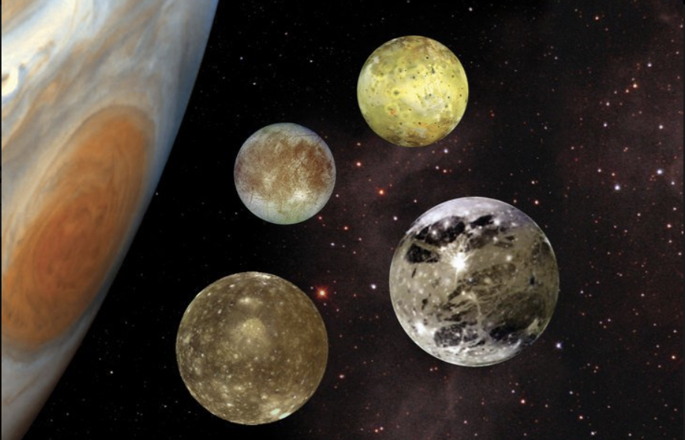
The Approach
Jupyter Notebook excerpts
The analysis process (accompanied by your Jupyter Notebook)

Slide 6
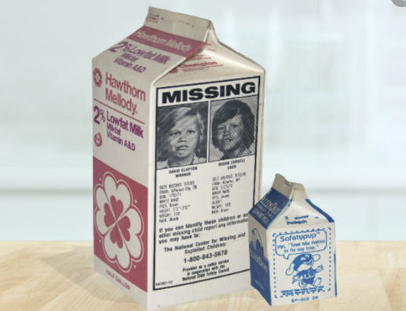
What We Found
Ages trafficked
graph
Industries graph
Your conclusions, which should include a numerical summary and visualizations of that summary

Slide 7
What Else We Found
Economics graphs?
Other data
Your conclusions, which should include a numerical summary and visualizations of that summary

Slide 8
Lessons Learned
Need help? United States:
1 (888) 373-7888
National Human Trafficking Hotline
SMS: 233733 (Text "HELP" or "INFO")
Hours: 24 hours, 7 days a week
Languages: English, Spanish and 200 more languages
Website: humantraffickinghotline.org
The implications of your findings: what do your findings mean?

Slide 9
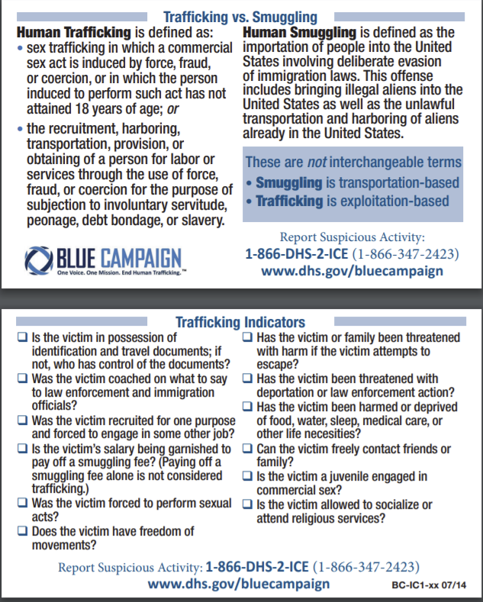
Appendix
US DHS
Add additional info here
https://www.dhs.gov/sites/default/files/publications/20_0115_plcy_human-trafficking-forced-labor-child-exploit-strategy.pdf

